Slide 1


Uber Data Analysis through Voronoi Diagrams
Presenters:
Nathan V
Manikumar D

Slide 2
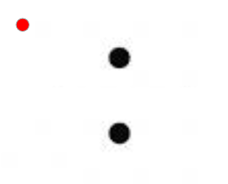
Introduction to Voronoi Diagrams
Suppose we are Given multiple points on a plane and a random point on that plane, which of the points is the random point closest to?
Can we generalize this?
Can we add more points?

Slide 3
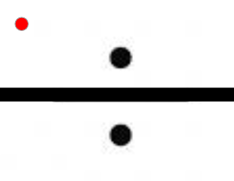
We can. By drawing perpendicular, bisecting lines between the points, we can make separate regions for which dot is closest.
This is a very simple Voronoi diagram that draws lines between points to generalize these questions

Slide 4
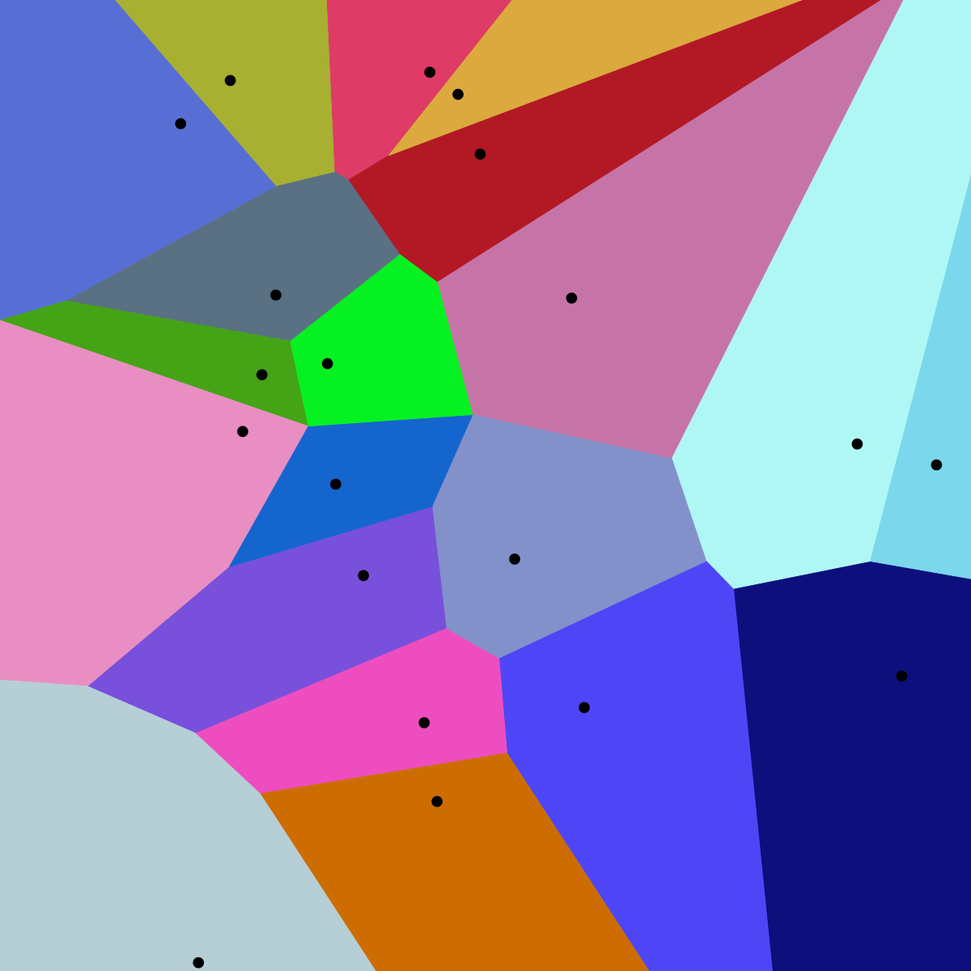
These diagrams can become much more complicated with more points!
Using these diagrams, we will analyze Uber data from New York City. One of the points will be where someone called for an Uber. The regions will then represent which client a driver is closest to.

Slide 5

Preparing Data for Diagrams
About Dataset ?
Data variables we have Date/Time, Latitude, Longitude, Base Location
Latitude and Longitude is on New York map.
We have a huge amount of data for this project, and if we used every point, the diagrams would become too cluttered for any analysis. Therefore, we will take repeated random samples of the data with different sizes to test how sensitive the models are?

Slide 6
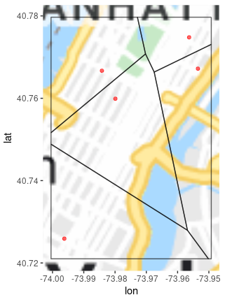
September 2021 Data
The number of points we use to make a Voronoi diagrams can dramatically change their shapes
Here we are using only 5 points for our diagram
You may notice how close these points are together

Slide 7
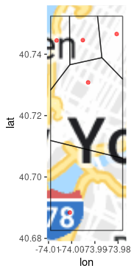
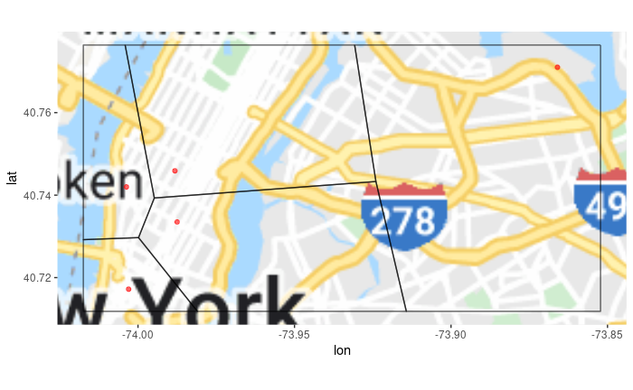
With another sample of 5 points, we can get a very different results.
The sample on the left is very similar, with points grouped close on Manhattan,
While the diagram on the right has only one point that deviates from that space
This shows that drivers in Manhattan will have a very short drive to reach their clients

Slide 8
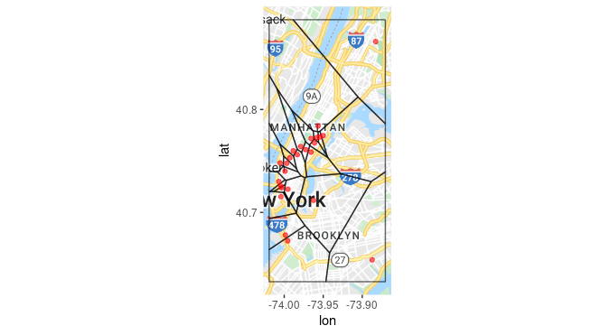
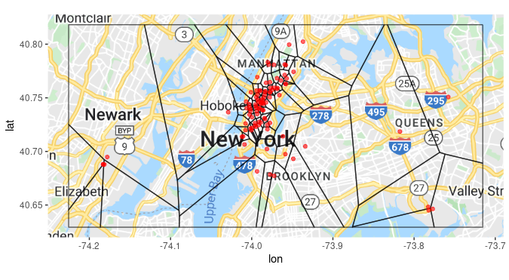
If we increased the number of points to 25 or 100 we find similar trends from the data
There is consistently a huge number of clients in Manhattan, and large gaps elsewhere
So drivers outside of Manhattan will generally have longer drivers to their clients

Slide 9
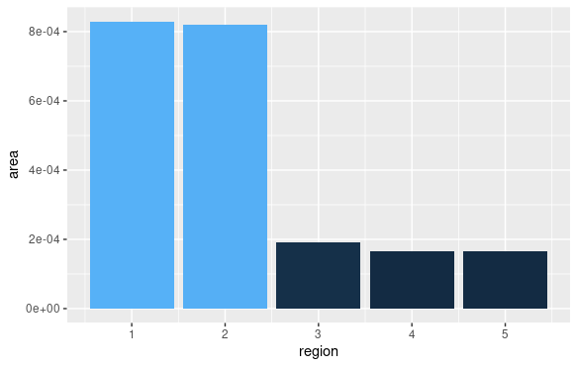
Area Sizes
We can look at this quantitatively
If we compare the areas of the Voronoi polygons, we can see that there are multiple smaller areas and only few large areas

Slide 10
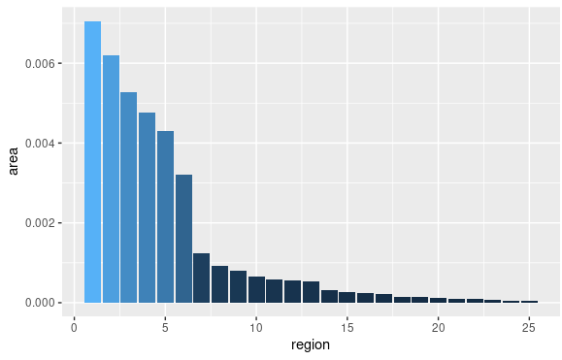
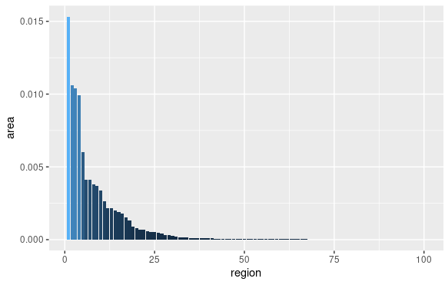
This is even more apparent with larger Voronoi diagrams. We add more areas, but they tend to just take up small areas in Manhattan

Slide 11
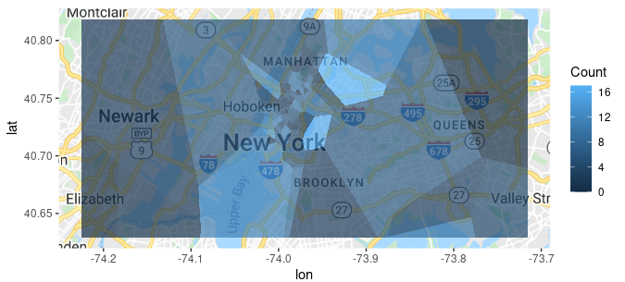
Choropleth Maps
Another way to visualize this is with heat maps. Using another sample of points from our data, we will color the different regions based on how many calls occur in that area.
Here we take 500 points and sort them into which of the 100 Voronoi polygons they occurred in. Areas colored brighter have more calls happen in them.

Slide 12
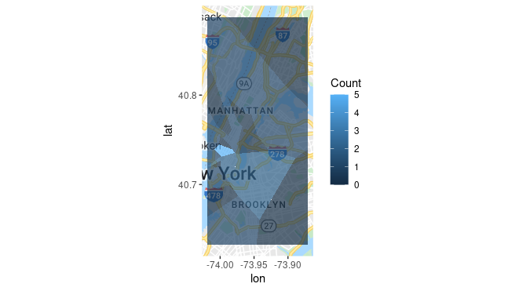
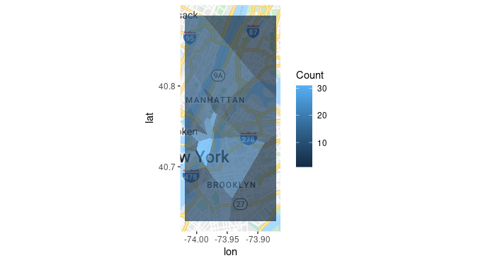
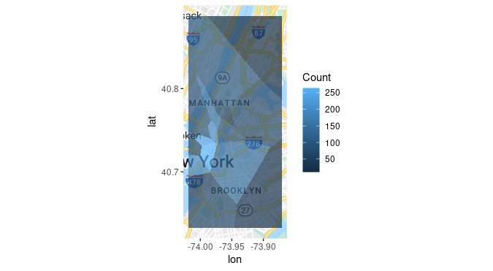
Now we’ll keep using the same 25 polygons, but differ the amount of points that go into them by 25, 250, and 2500 points. The results are strikingly similar

Slide 13
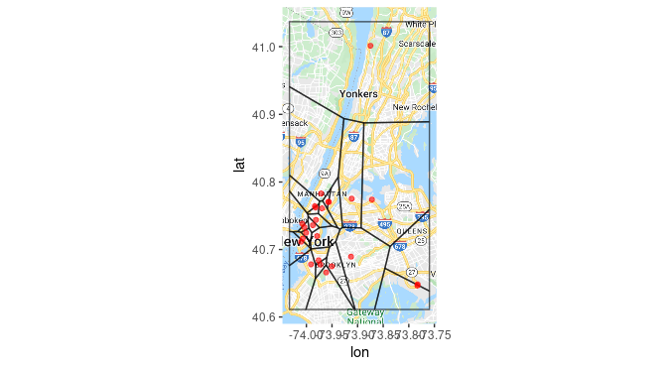
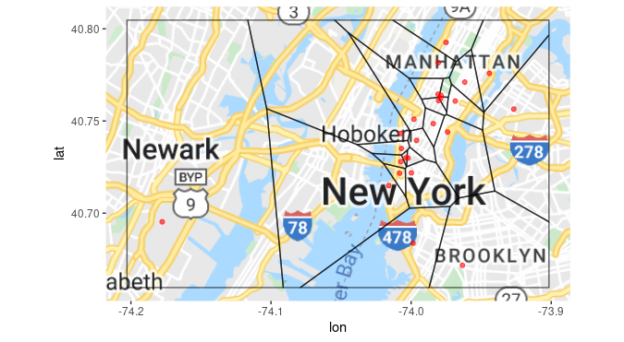
Data Over Time
We see a similar trend carrying on through the other 5 months of our data
Here we made diagrams with data from October and November

Slide 14
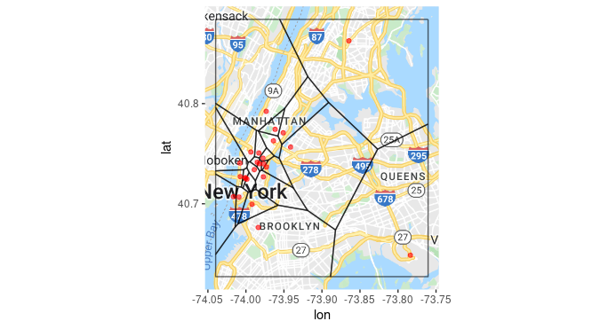
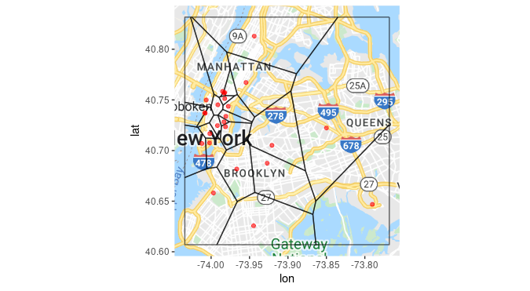
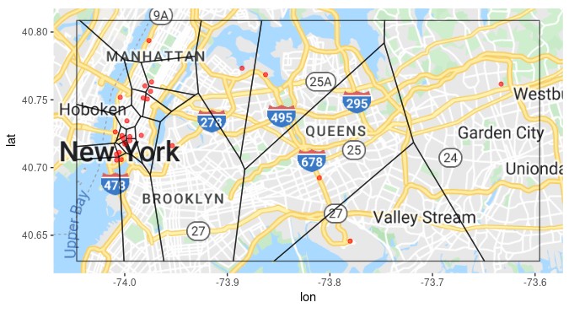
And here we have Voronoi diagrams using data from December, January, and February
Interestingly, they seem to commonly have more spread-out points than September did

Slide 15
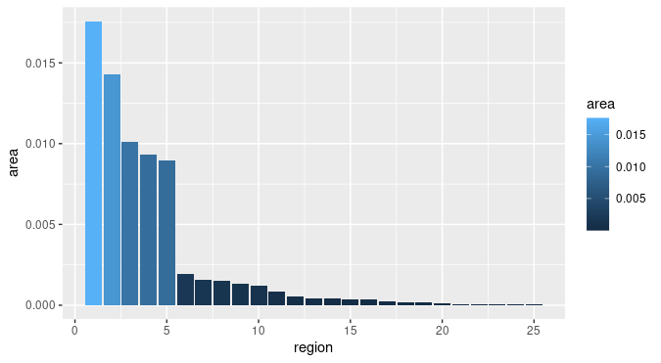
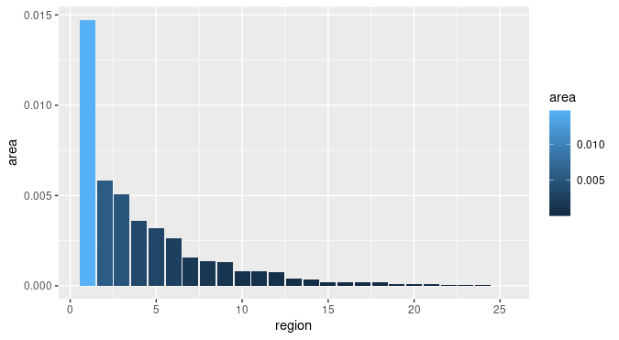
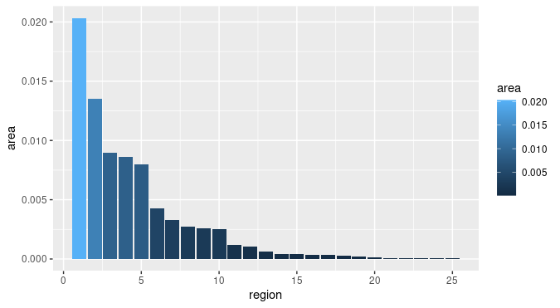
The areas of the Voronoi Polygons have similar trends. Here we graph October, December, and February. These present similar trends from September’s data, and also with each other

Slide 16
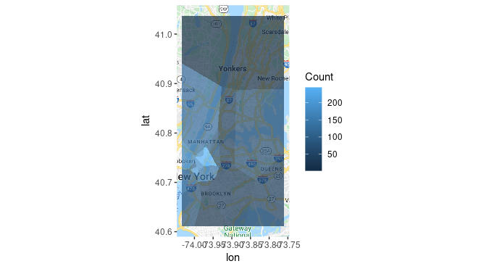
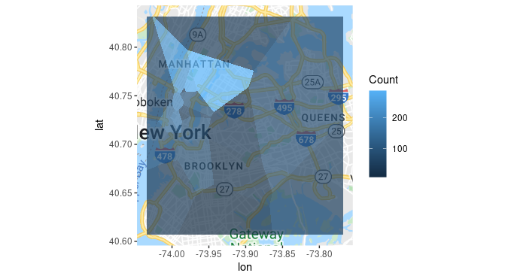
Finally, we will create heat maps using November and January’s data and running 2500 points. We see the immense amount of clients in the Manhattan area again, but compared to September, they are more spread out and doesn’t reach the same severity

Slide 17
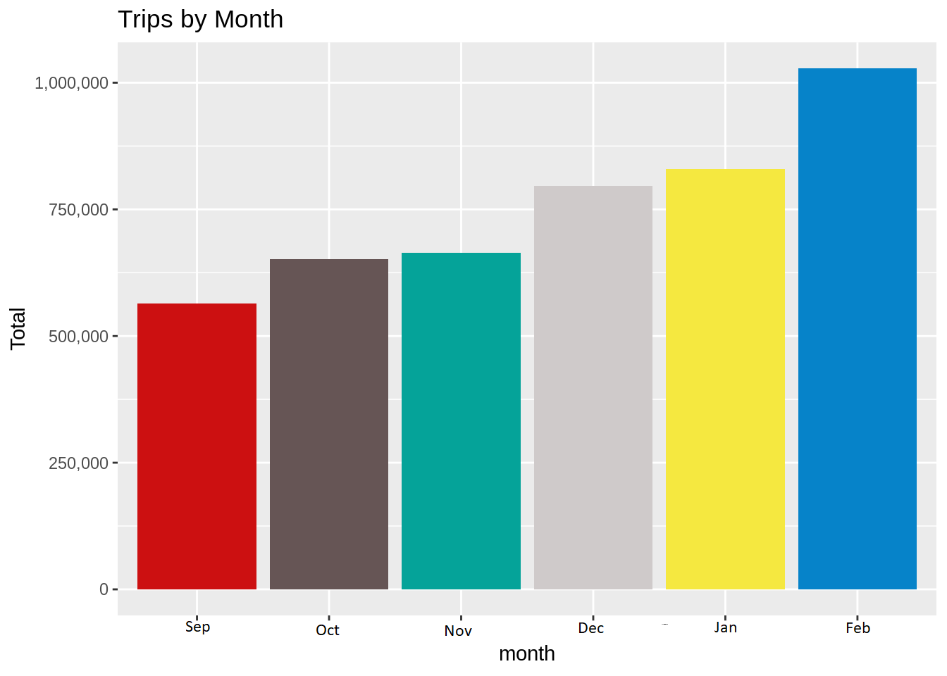
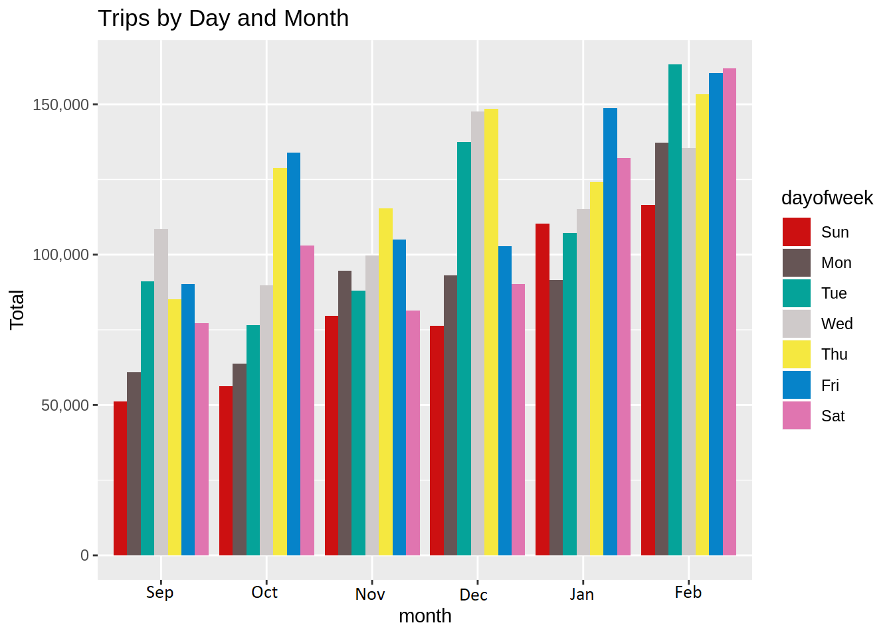
Our Analysis through visualization we can easily say that trips by each month have rapidly increased.
In each month trips by week, we can see that Thursday and Friday has the greatest number of bookings.

Slide 18
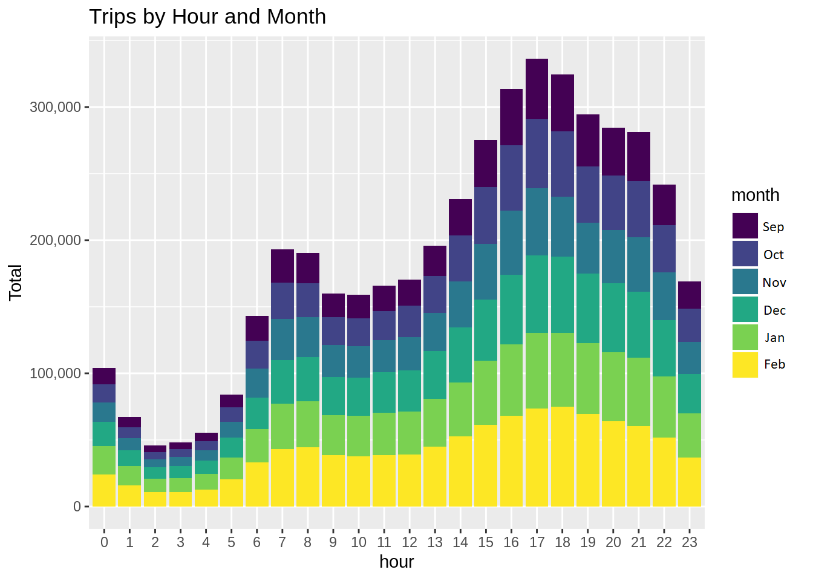
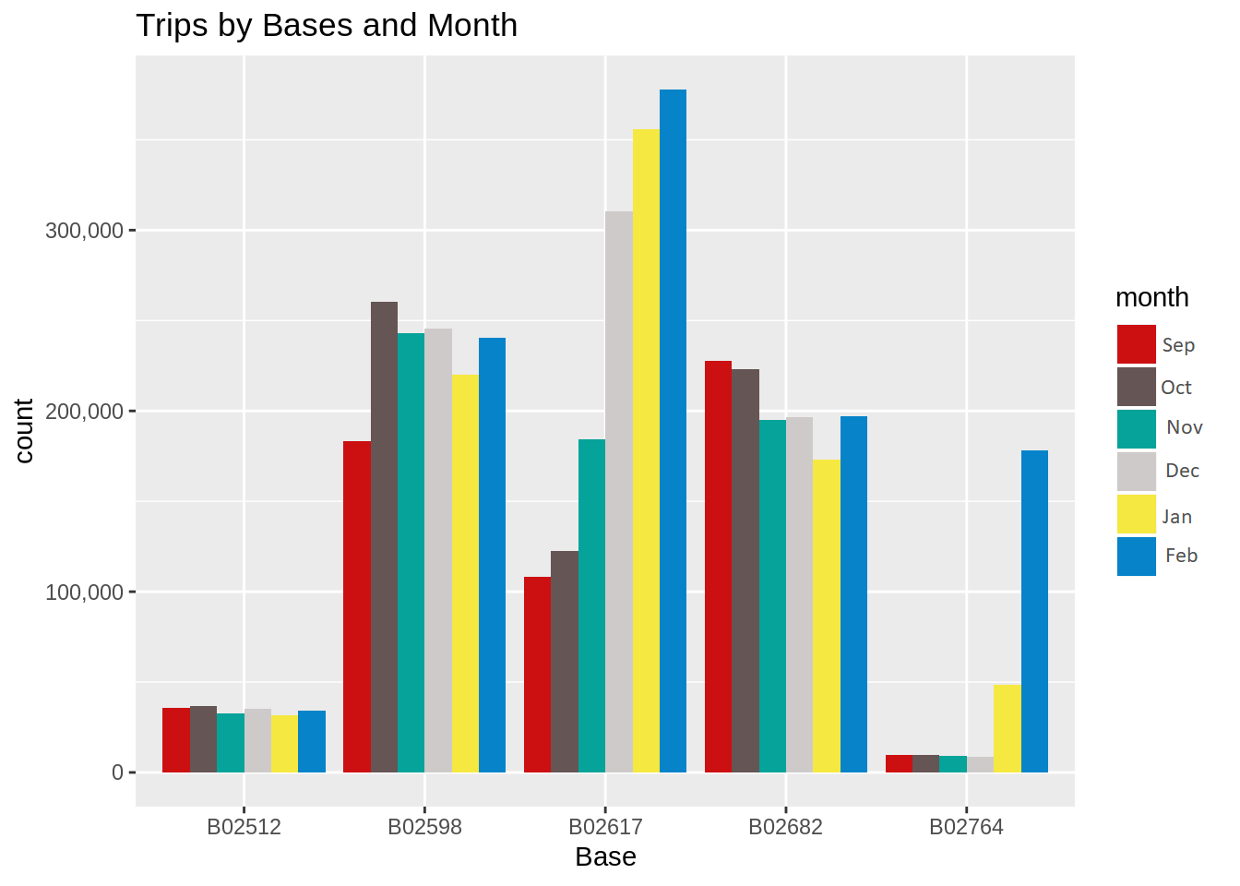
In the resulting visualizations, we can understand how the number of passengers fares throughout the day.
We observe that the number of trips are higher in the evening around 5:00 and 6:00 PM.
Over 5 bases only 3 are busy and see how trips increased each month.

Slide 19
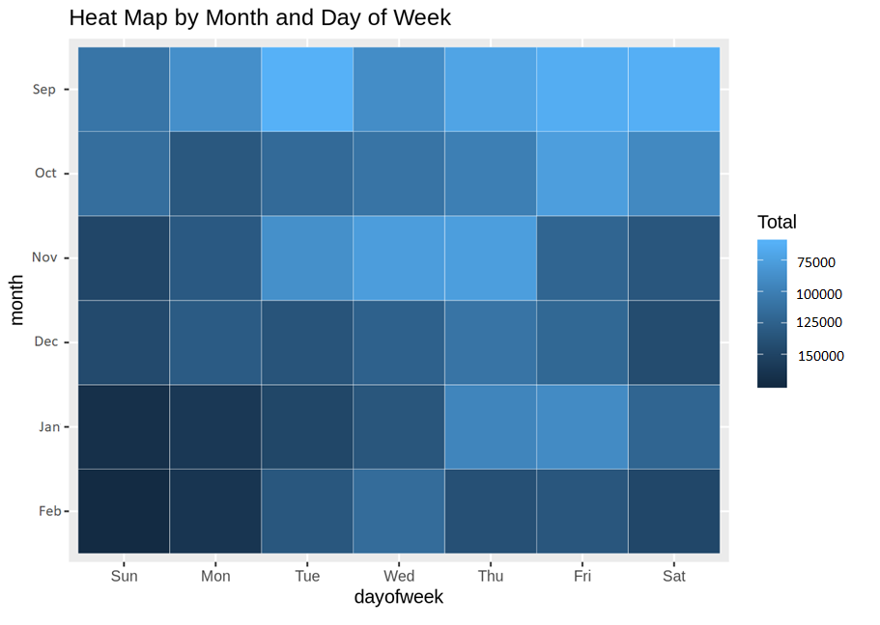
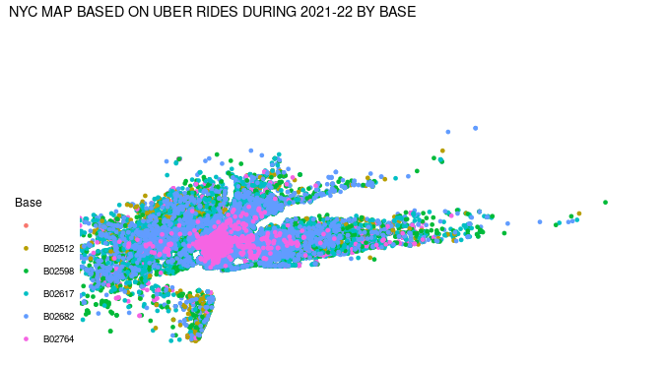
The key benefit of this heatmap to simplify complex numerical data and that can be understood at a glance. heatmaps ‘dark’ color depict high user engagement, while ‘light’ color depict low engagement.
we made a geo plot of New York that provided us with the details of how various users made trips from different bases.

Slide 20
Future Possibilities
Work with Actual Roads
Our diagrams have the constraint of ignoring the roads to consider which client is closest to a driver
Could somehow incorporate road paths into diagrams
Shiny App
Creating a Shiny App with our data could be very effective
It could allow users to choose the month of data, how many points to use in the Voronoi Diagrams, and how many points to use in the choropleth map
Unfortunately, we did not have time to incorporate the code we made into this

